Slide 1


DATA ANALYST PORTFOLIO PROJECT
BANK LOAN ANALYSIS
PART 1
MS SQL SERVER

Slide 2
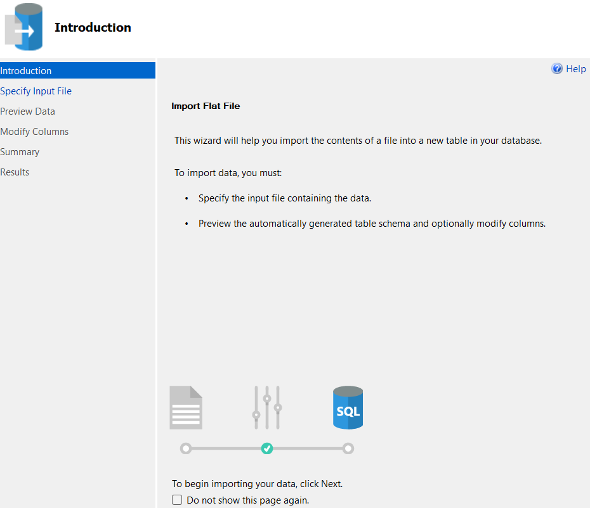

MS SQL SERVER
IMPORT
DATA

Slide 3

MS SQL SERVER
CREATING
DB

Slide 4
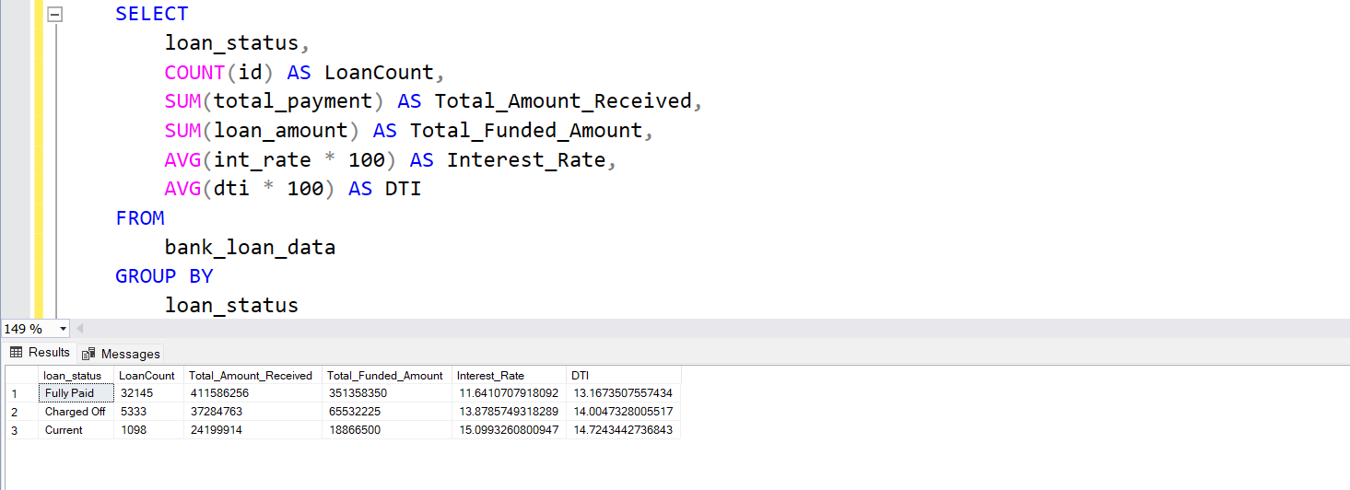
MS SQL SERVER
WRITING
QUERIES

Slide 5

SQL
FIRING SQL QUERIES TO SOLVE THE BUSINESS PROBLEMS
COMPARING RESULTS WITH POWER BI, TABLEAU and EXCEL
You can use the data in any DB to fire queries. Queries used will remain same

Slide 6

DATA ANALYST PORTFOLIO PROJECT
BANK LOAN ANALYSIS
PART 2
POWER BI

Slide 7


POWER BI
CONNECTING TO
MS SQL SERVER

Slide 8
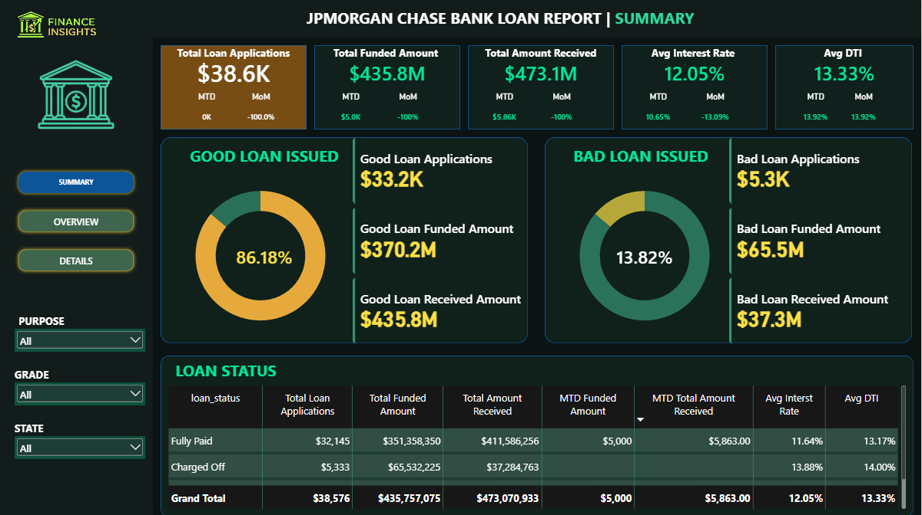
POWER BI

Slide 9
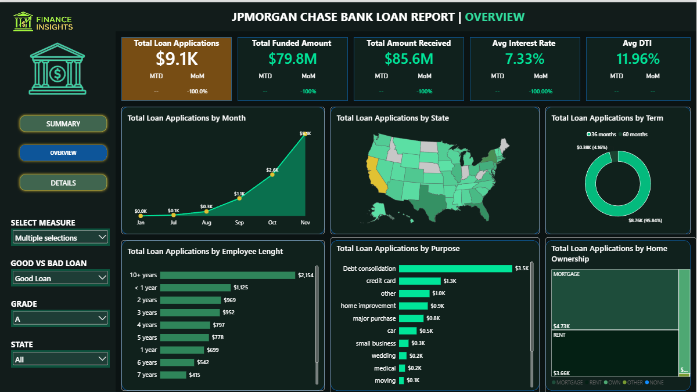
POWER BI

Slide 10
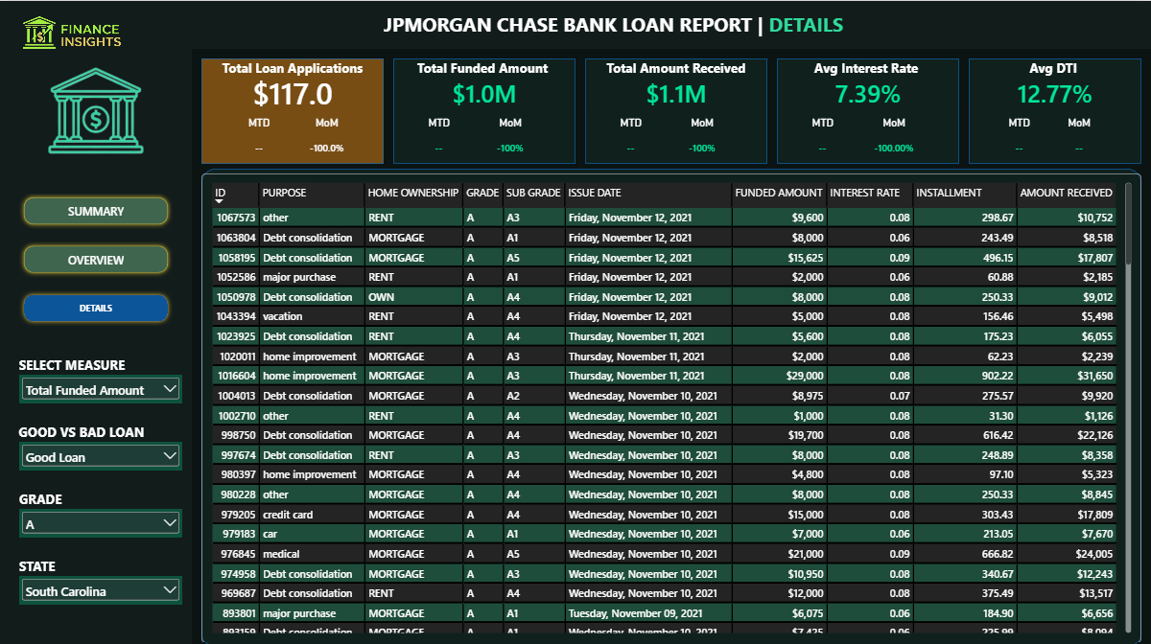
POWER BI

Slide 11
PROBLEM STATEMENT
DASHBOARD 1: SUMMARY
Key Performance Indicators (KPIs) Requirements:
Total Loan Applications: We need to calculate the total number of loan applications received during a specified period. Additionally, it is essential to monitor the Month-to-Date (MTD) Loan Applications and track changes Month-over-Month (MoM).
Total Funded Amount: Understanding the total amount of funds disbursed as loans is crucial. We also want to keep an eye on the MTD Total Funded Amount and analyse the Month-over-Month (MoM) changes in this metric.
Total Amount Received: Tracking the total amount received from borrowers is essential for assessing the bank's cash flow and loan repayment. We should analyse the Month-to-Date (MTD) Total Amount Received and observe the Month-over-Month (MoM) changes.
Average Interest Rate: Calculating the average interest rate across all loans, MTD, and monitoring the Month-over-Month (MoM) variations in interest rates will provide insights into our lending portfolio's overall cost.
Average Debt-to-Income Ratio (DTI): Evaluating the average DTI for our borrowers helps us gauge their financial health. We need to compute the average DTI for all loans, MTD, and track Month-over-Month (MoM) fluctuations.

Slide 12
PROBLEM STATEMENT
DASHBOARD 1: SUMMARY
Good Loan v Bad Loan KPI’s
Good Loan:
Good Loan Application Percentage
Good Loan Applications
Good Loan Funded Amount
Good Loan Total Received Amount
Bad Loan
Bad Loan Application Percentage
Bad Loan Applications
Bad Loan Funded Amount
Bad Loan Total Received Amount
Loan Status Grid View
In order to gain a comprehensive overview of our lending operations and monitor the performance of loans, we aim to create a grid view report categorized by 'Loan Status.’ By providing insights into metrics such as 'Total Loan Applications,' 'Total Funded Amount,' 'Total Amount Received,' 'Month-to-Date (MTD) Funded Amount,' 'MTD Amount Received,' 'Average Interest Rate,' and 'Average Debt-to-Income Ratio (DTI),' this grid view will empower us to make data-driven decisions and assess the health of our loan portfolio.

Slide 13
PROBLEM STATEMENT
DASHBOARD 2: OVERVIEW
CHARTS
Monthly Trends by Issue Date (Line Chart): To identify seasonality and long-term trends in lending activities
Regional Analysis by State (Filled Map): To identify regions with significant lending activity and assess regional disparities
Loan Term Analysis (Donut Chart): To allow the client to understand the distribution of loans across various term lengths.
Employee Length Analysis (Bar Chart): How lending metrics are distributed among borrowers with different employment lengths, helping us assess the impact of employment history on loan applications.
Loan Purpose Breakdown (Bar Chart): Will provide a visual breakdown of loan metrics based on the stated purposes of loans, aiding in the understanding of the primary reasons borrowers seek financing.
Home Ownership Analysis (Tree Map): For a hierarchical view of how home ownership impacts loan applications and disbursements.
Metrics to be shown: 'Total Loan Applications,' 'Total Funded Amount,' and 'Total Amount Received'

Slide 14
PROBLEM STATEMENT
DASHBOARD 3: DETAILS
GRID
Need for a comprehensive 'Details Dashboard' that provides a consolidated view of all the essential information within our loan data. This Details Dashboard aims to offer a holistic snapshot of key loan-related metrics and data points, enabling users to access critical information efficiently.
Objective:
The primary objective of the Details Dashboard is to provide a comprehensive and user-friendly interface for accessing vital loan data. It will serve as a one-stop solution for users seeking detailed insights into our loan portfolio, borrower profiles, and loan performance.

Slide 15
FUNCTIONALITIES YOU WILL LEARN
SQL – MS SQL SERVER
POWER BI
Creating Database
Creating Table
Select
Datename
Datepart
Cast
Decimal
Month
Hour
Quarter
Day
Group by
Order by
Decimal
Limit
Count
Distinct
CTE
Partition
Connecting to SQL Server
Data Cleaning
Data Modelling
Data Processing
Power Query
Date Tables
Time Intelligence Func
DAX
Date Function
Text Function
Filter Function
Calculate
SUM/ SUMX
Creating KPI’s
New Card Visual
Creating Charts
Formatting visuals
Creating Functions
Navigations

Slide 16
SOFTWARE USED
MS OFFICE/ EXCEL: VERSION 2610
MS SQL SERVER: VERSION 17.0(2025)
SQL SERVER MANAGEMENT STUDIO – VERSION 22.11.3
POWER BI: NOVEMBER 2026 Version

